Slide 1

PRESENT PERFECT
Ayu Pratiwi Ulfah, S.Hum., M.Hum.

Slide 2
Functions of Present Perfect:
We use the present perfect for something that started in the past and continues in the present
Time signal: ever, already, just, yet, since, for

Slide 3
Two kind of sentences:
Verbal (action, mental)
Nominal
(+) S + have/ has + V3
(-) S + have/ has + not + V3
(?) Have/ has + S + V3?
(+) We have studied in Unikom since September 2021 and now I am an Unikom’s students.
(-) we Have not studied in Unikom since September 2021.
(?) Have we studies in Unikom since September 2021?
(+) S + have/ has + been + adv/adj.
(-) S + have/ has + not +been + adv/adj.
(?) Have/ has + S + been + adv/adj?
(+) You have been here for one hour and now you are here.

Slide 4
Language Features:
SUBJECT | AUXILARY VERBS
I | have
YOU | have
THEY | have
WE | have
SHE | has
HE | has
IT | has
NAME | has
NAME(S) | have

Slide 5
Language Features:
REGULAR VERBS |  |  | IRREGULAR VERBS
V1 (Base Form) | V2 (Simple Past) | V3 (Past Participle) | V1 (Base Form) | V2 (Simple Past) | V3 (Past Participle)
cook | cooked | cooked | go | went | Gone
play | played | played | sing | sang | Sung
study | studied | studied | swim | Swam | Swum
Watch | watched | watched | eat | ate | Eaten
Kick | Kicked | Kicked | cut | cut | Cut
Want | Wanted | Wanted | bet | bet | bet
cry | Cried | Cried | put | put | put
look | looked | looked | buy | bought | bought

Slide 6
PAST PERFECT
Ayu Pratiwi Ulfah, S.Hum., M.Hum.

Slide 7
Functions of Past Perfect:
The past perfect is a verb tense which is used to show that an action took place once or many times before another point in the past.

Slide 8
Two kind of sentences:
Verbal (action, mental)
Nominal
(+) S + had + V3
(-) S + had + not + V3
(?) Had + S + V3?
(+) She had never seen a bear before she moved to Alaska.
(-) She hadn’t never seen a bear before she moved to Alaska.
(?) Had she never seen a bear before she moved to Alaska.
(+) S + had + been + adv/adj
(-) S + had + not + been + adv/adj
(?) Had + S + been + adv/adj?
(+) By the time Alex finished his studies, he had been in London for eight years.

Slide 9
Examples:
The earthquake had happened before the tsunami came.
The tsunami came after the earthquake had happened.

Slide 10
Language Features:
SUBJECT | AUXILARY VERBS
I | HAD
YOU
THEY
WE
SHE
HE
IT
NAME
NAME(S)

Slide 11
Language Features:
REGULAR VERBS |  |  | IRREGULAR VERBS
V1 (Base Form) | V2 (Simple Past) | V3 (Past Participle) | V1 (Base Form) | V2 (Simple Past) | V3 (Past Participle)
cook | cooked | cooked | go | went | Gone
play | played | played | sing | sang | Sung
study | studied | studied | swim | Swam | Swum
Watch | watched | watched | eat | ate | Eaten
Kick | Kicked | Kicked | cut | cut | Cut
Want | Wanted | Wanted | bet | bet | bet
cry | Cried | Cried | put | put | put
look | looked | looked | buy | bought | bought

Slide 12
Simple Future
Ayu Pratiwi Ulfah, S.Hum., M.Hum.

Slide 13
Functions of Simple Future:
The simple future is a verb tense that’s used to talk about things that haven’t happened yet.

Slide 14
Two kind of sentences:
Verbal (action, mental)
nominal
(+) S + will + V1
(-) S+ won’t+ V1
(?) Will + S + V1?
(+) I will eat meatball.
(-) I wont eat meatball.
(+) S + will + be
(-) S+ won’t + be
(?) Will + S + be?
(+) I will be a programmer.
(-) I wont (will not) be a programmer.

Slide 15
Two kind of sentences:
Verbal (action, mental)
nominal
(+) S + to be + going to + V1
(-) S+ to be + not + going to + V1
(?) to be going to + S + V1?
(+) I am going to eat meatball at 2 pm.
(+) they are going to eat meatball at 2 pm.
(+) She is going to eat meatball at 2 pm.
(+) S + to be +going to + be
(-) S+ to be + not + going to + be
(?) to be +going to + S + be?
(+) I am going to be a programmer I 2025.

Slide 16
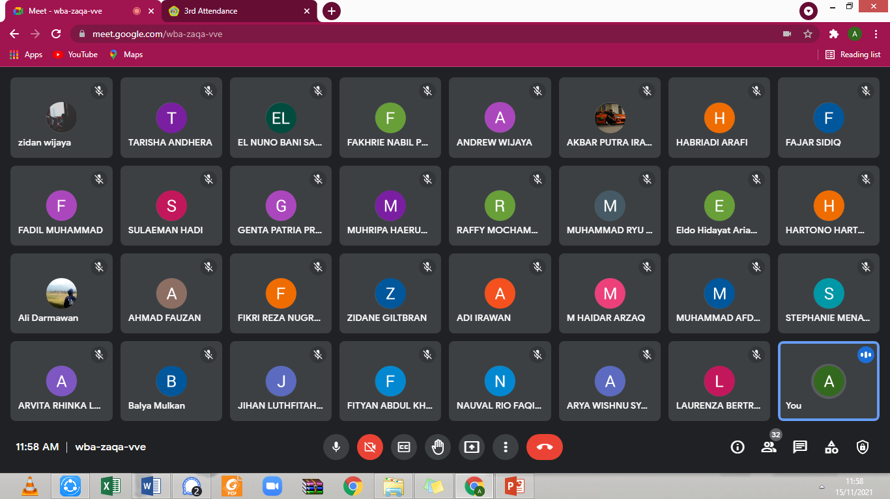

Slide 17
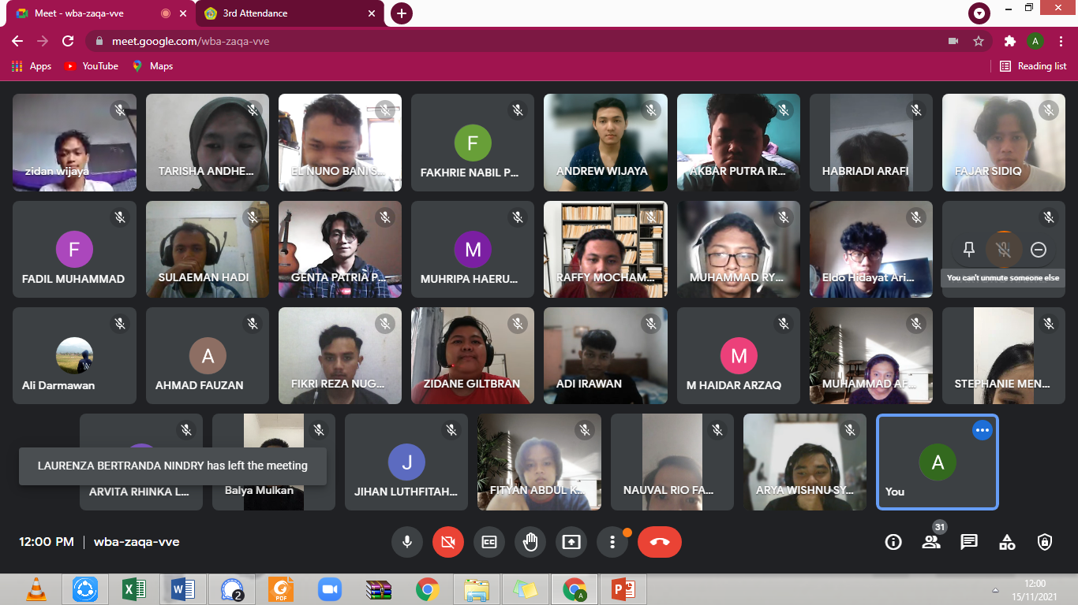

Slide 18
